Slide 1
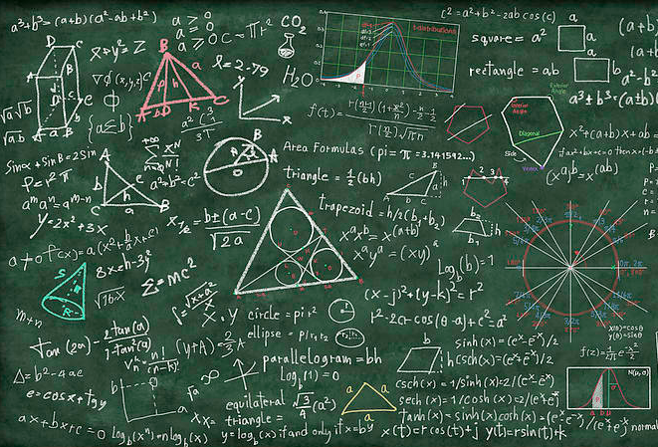
Lecture 19: Aggregate Demand
Outline
Expanded IS
Monetary policy and prices
Aggregate Demand
Required reading:
Mishkin Ch 9: all
Mishkin Ch 10: selections
Stevenson Wolfers Ch 21: selections

Slide 2
Expanded IS
Macro is a study of the relationships between a small handful of variables
Last class, we related two of the big ones: r and Y.
One of the most important macro variables was omitted: prices
The rate of inflation (π) changes along with the business cycle. Today, we tie it into the model
This is probably the lecture with the most math.
It’s useful and important. That’s Econ!
We’ve actually set up about 90% of today’s content. The math just “formalizes” and “specifies” it.
Notes:
“Formal” means something along the line of “formal logic” – we state it symbolically, which allows for more clarity and rigor.
“Specifies” means “getting specific”. Our equations will have very precise structures. Those structures are useful, but of course require certain assumptions (first among them, linearity).

Slide 3
Expanded IS
Our definition of AE goes
AE = C + I_{p} + G + NX
Where we know that everything in that equation is a function of the real interest rate r:
AE(r) = C(Y,r) + I_{p}(r) + G(r) + NX(r)
Let’s start with government spending G(r)
Spending had two components:
A portion that changes with interest rates
An autonomous portion that doesn’t change with interest rates

Slide 4
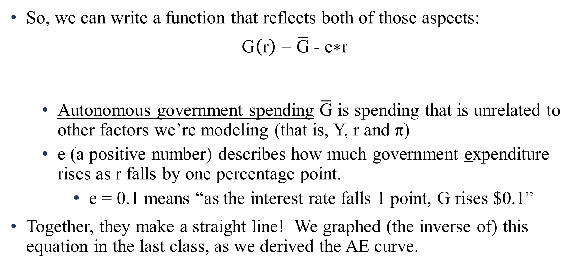
Expanded IS
So, we can write a function that reflects both of those aspects:
$$\text{G}\left(\text{r}\right)\text{ = }\overline{\text{G}}\text{ − }\text{e}\text{∗}\text{r}$$
Autonomous government spending $\overline{\text{G}}$is spending that is unrelated to other factors we’re modeling (that is, Y, r and π)
e (a positive number) describes how much government expenditure rises as r falls by one percentage point.
e = 0.1 means “as the interest rate falls 1 point, G rises $0.1”
Together, they make a straight line! We graphed (the inverse of) this equation in the last class, as we derived the AE curve.
Government spending equals
a fixed autonomous sum
, plus a portion that decreases as interest rises
Notes:
We graphed a relationship between G and r last class. That put interest (a price!) on the vertical and G (a quantity) on the horizontal, as usual. This function has G on the left hand side. So as usual, this question is the government spending function, but what we graphed is the INVERSE government spending function. It usually isn’t very interesting to graph this function, so we won’t worry about it here.

Slide 5
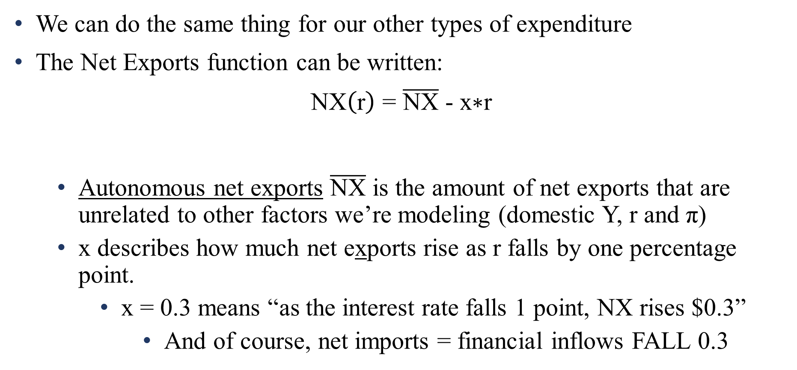
Expanded IS
We can do the same thing for our other types of expenditure
The Net Exports function can be written:
$$\text{NX}\left(\text{r}\right)\text{ = }\overline{\text{NX}}\text{ − }\text{x}\text{∗}\text{r}$$
Autonomous net exports $\overline{\text{NX}}$is the amount of net exports that are unrelated to other factors we’re modeling (domestic Y, r and π)
x describes how much net exports rise as r falls by one percentage point.
x = 0.3 means “as the interest rate falls 1 point, NX rises $0.3”
And of course, net imports = financial inflows FALL 0.3
Net exports equals
a fixed autonomous sum
, plus a portion that decreases as interest rises
Notes:
Net imports fall as interest falls because NX = EX-IM is the negative of net imports = IM-EX. And financial inflows fall because NX equals the BoP on current accounts, and CA = -FA.

Slide 6
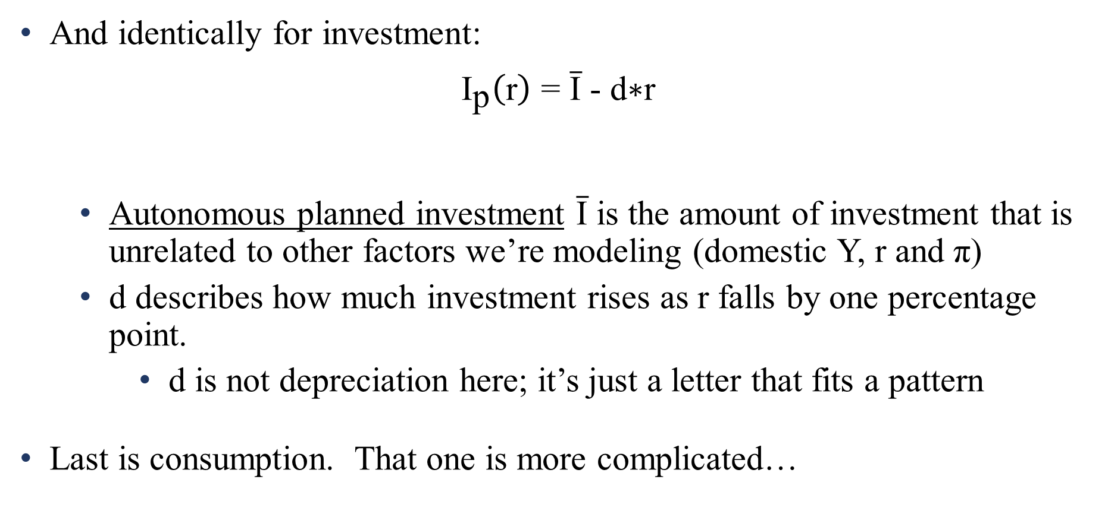
Expanded IS
And identically for investment:
$${\text{I}}_{\text{p}}\left(\text{r}\right)\text{ = }\overline{\text{I}}\text{ − }\text{d}\text{∗}\text{r}$$
Autonomous planned investment $\overline{\text{I}}$is the amount of investment that is unrelated to other factors we’re modeling (domestic Y, r and π)
d describes how much investment rises as r falls by one percentage point.
d is not depreciation here; it’s just a letter that fits a pattern
Last is consumption. That one is more complicated…
Planned investment equals
a fixed autonomous sum
, plus a portion that decreases as interest rises

Slide 7
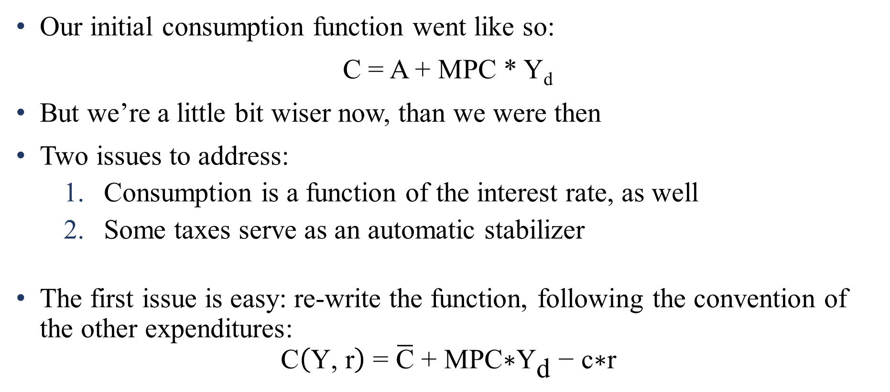
Expanded IS
Our initial consumption function went like so:
C = A + MPC * Y_{d}
But we’re a little bit wiser now, than we were then
Two issues to address:
Consumption is a function of the interest rate, as well
Some taxes serve as an automatic stabilizer
The first issue is easy: re-write the function, following the convention of the other expenditures:
$$\text{C}\left(\text{Y}\text{, }\text{r}\right)\text{ = }\overline{\text{C}}\text{ + }\text{MPC}\text{∗}{\text{Y}}_{\text{d}}\text{ − }\text{c}\text{∗}\text{r}$$

Slide 8
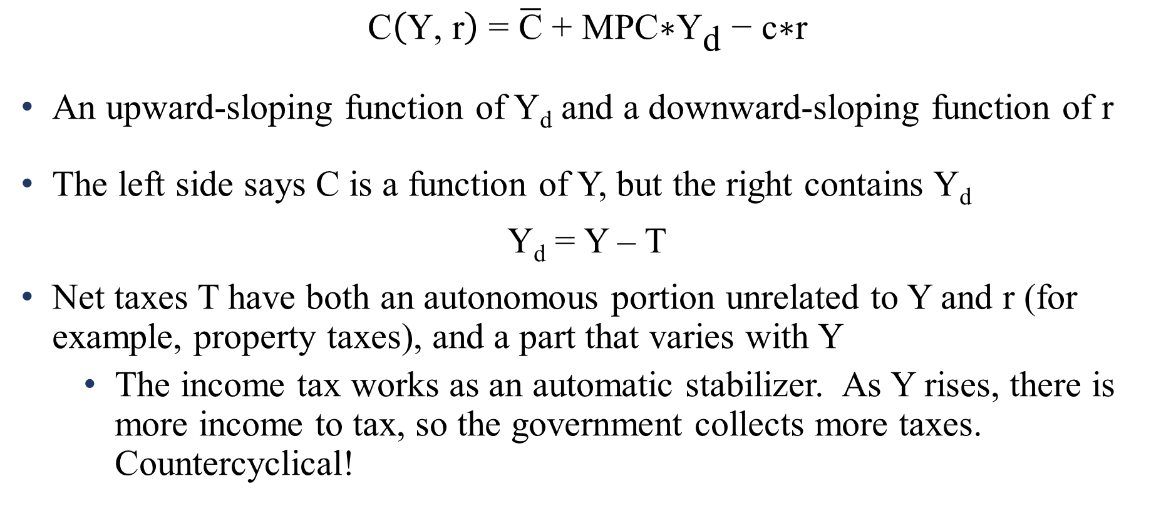
Expanded IS
$$\text{C}\left(\text{Y}\text{, }\text{r}\right)\text{ = }\overline{\text{C}}\text{ + }\text{MPC}\text{∗}{\text{Y}}_{\text{d}}\text{ − }\text{c}\text{∗}\text{r}$$
An upward-sloping function of Y_{d} and a downward-sloping function of r
The left side says C is a function of Y, but the right contains Y_{d}
Y_{d} = Y – T
Net taxes T have both an autonomous portion unrelated to Y and r (for example, property taxes), and a part that varies with Y
The income tax works as an automatic stabilizer. As Y rises, there is more income to tax, so the government collects more taxes. Countercyclical!
Notes:
Why am I calling T “net taxes”? Because it incorporates both taxes and transfers – money passed back and forth between households and the government.
We don’t generally think of taxes varying with r. While there is some spending that changes with r, that’s because the spending involves an intertemporal component – interest payments on government borrowing are made over time. Large projects are funded over a long time period. But with taxes, they tend to be one-and-done. You pay taxes one year, you pay taxes the next. The policy doesn’t tend to change BECAUSE of changes in r.

Slide 9
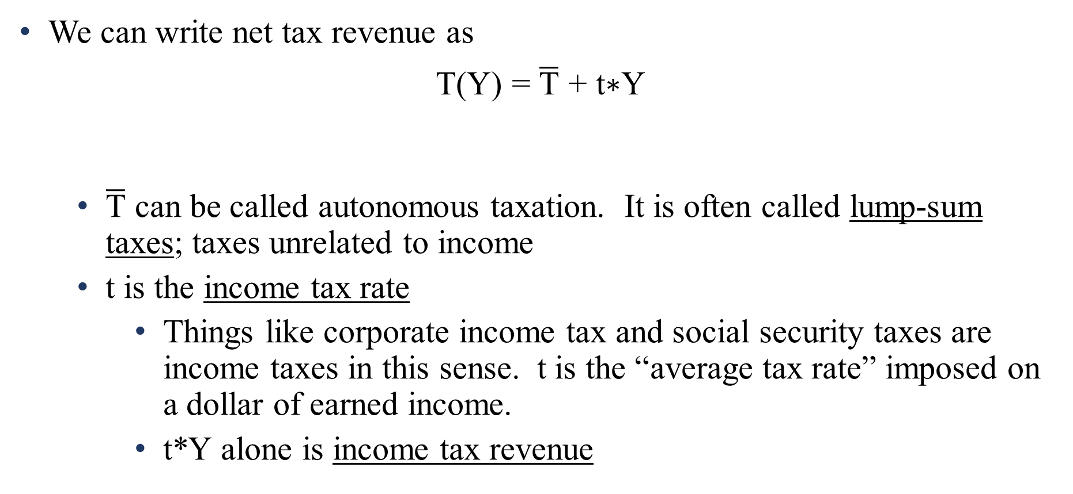
Expanded IS
We can write net tax revenue as
T(Y) = $\overline{\text{T}}\text{ + }\text{t}\text{∗}\text{Y}$
$\overline{\text{T}}$ can be called autonomous taxation. It is often called lump-sum taxes; taxes unrelated to income
t is the income tax rate
Things like corporate income tax and social security taxes are income taxes in this sense. t is the “average tax rate” imposed on a dollar of earned income.
t*Y alone is income tax revenue
Net tax revenue
equals a fixed autonomous sum
, plus a portion that increases as income rises

Slide 10
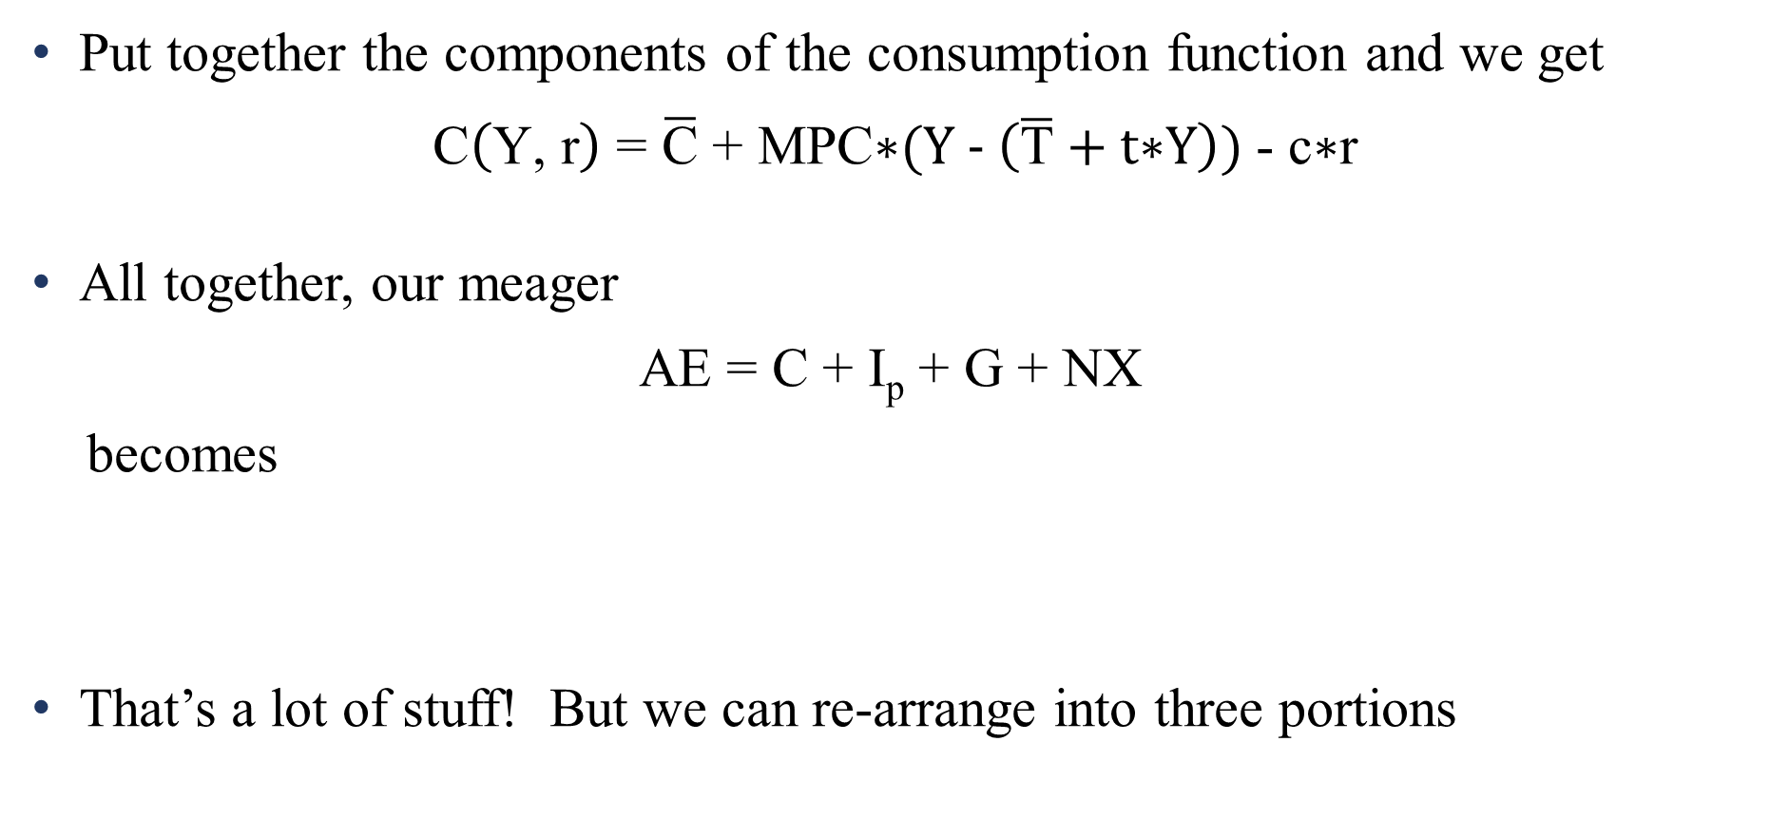
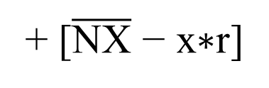
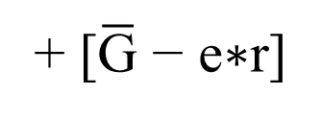
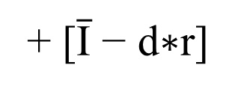
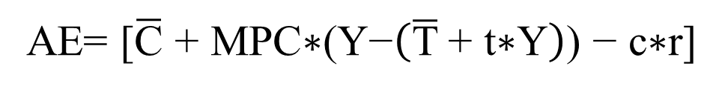

Expanded IS
Put together the components of the consumption function and we get
$$\text{C}\left(\text{Y}\text{, }\text{r}\right)\text{ = }\overline{\text{C}}\text{ + }\text{MPC}\text{∗}\text{(}\text{Y}\text{ − }\left(\overline{\text{T}} \text{+ }\text{t}\text{∗}\text{Y}\right)\text{) }\text{− }\text{c}\text{∗}\text{r}$$
All together, our meager
AE = C + I_{p} + G + NX
becomes
That’s a lot of stuff! But we can re-arrange into three portions
= Y_{d} = Y - T
AE= [$\overline{\text{C}}\text{ + }\text{MPC}\text{∗(}\text{Y}\text{−}\left(\overline{\text{T}} \text{+ }\text{t}\text{∗}\text{Y}\right)\text{) − }\text{c}\text{∗}\text{r}\text{]}$
+ [$\overline{\text{I}}\text{ − }\text{d}\text{∗}\text{r}$]
+ [$\overline{\text{G}}\text{ − }\text{e}\text{∗}\text{r}$]
+ [$\overline{\text{NX}}\text{ − }\text{x}\text{∗}\text{r}$]
Notes:
That first line is a mess!
C = Cbar + MPC*Yd – cr
Yd = Y – T
T = Tbar + tY
So
Yd = Y – (Tbar + tY) and therefore
C = Cbar + MPC*[Y – (Tbar + tY)] - cr

Slide 11
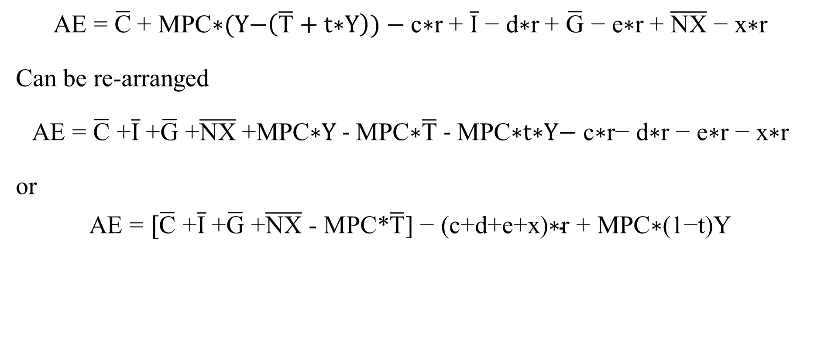

Expanded IS
AE = $\overline{\text{C}} \text{+ }\text{MPC}\text{∗}\text{(}\text{Y}\text{−}\left(\overline{\text{T}} \text{+ }\text{t}\text{∗}\text{Y}\right)\text{) − }\text{c}\text{∗}\text{r}$ + $\overline{\text{I}}\text{ − }\text{d}\text{∗}\text{r}$ + $\overline{\text{G}}\text{ − }\text{e}\text{∗}\text{r}$ + $\overline{\text{NX}}\text{ − }\text{x}\text{∗}\text{r}$
Can be re-arranged
AE = $\overline{\text{C}}\text{ +}\overline{\text{I}}\text{ +}\overline{\text{G}}\text{ +}\overline{\text{NX}} \text{+}\text{MPC}\text{∗}\text{Y}\text{ − }\text{MPC}\text{∗}\overline{\text{T}}\text{ − }\text{MPC}\text{∗}\text{t}\text{∗}\text{Y}\text{− }\text{c}\text{∗}\text{r}\text{− }\text{d}\text{∗}\text{r}\text{ − }\text{e}\text{∗}\text{r}\text{ − }\text{x}\text{∗}\text{r}$
or
AE = $[\overline{\text{C}}\text{ +}\overline{\text{I}}\text{ +}\overline{\text{G}}\text{ +}\overline{\text{NX}}\text{ − }\text{MPC}\text{∗}\overline{\text{T}}\text{] }\text{− }\text{(}\text{c}\text{+}\text{d}\text{+}\text{e}\text{+}\text{x}\text{)∗}\text{r} \text{+ }\text{MPC}\text{∗(1−}\text{t}\text{)}\text{Y}$
Autonomous spending
, plus spending that varies with interest
, plus spending that varies with income
Notes:
The second line just involves pushing the autonomous “bar” variables to the left, the “slope” terms multiplied by r to the right, and then expanding out that MPC mess of parentheses in the middle

Slide 12
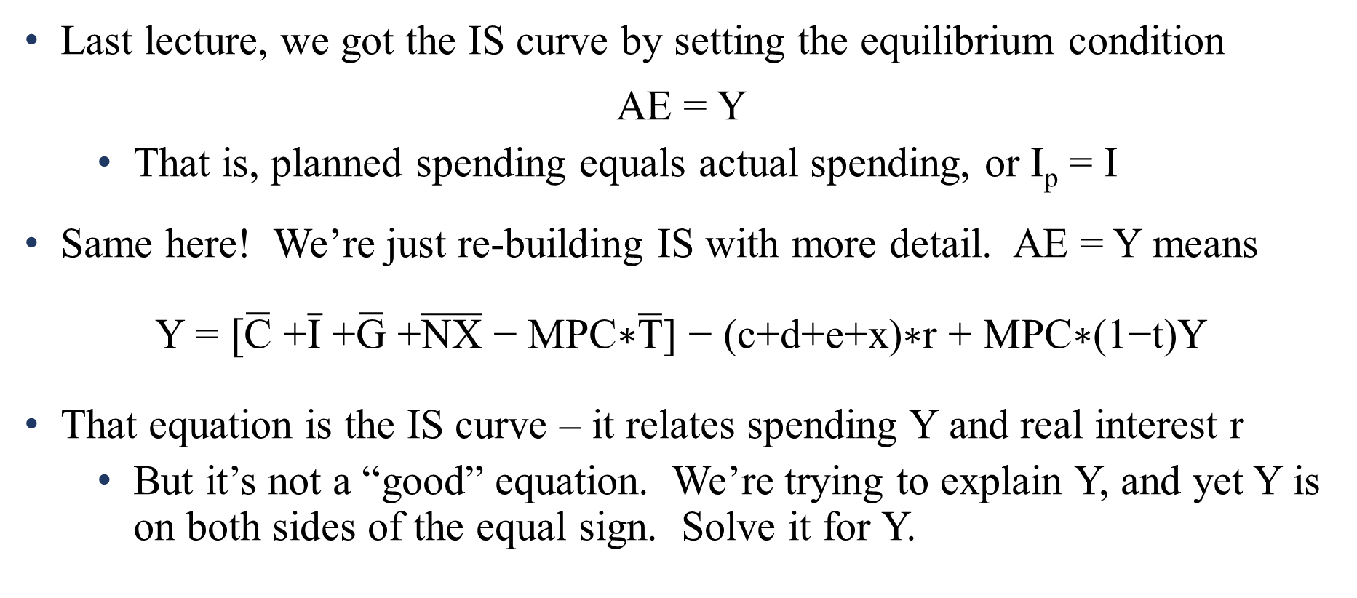
Expanded IS
Last lecture, we got the IS curve by setting the equilibrium condition
AE = Y
That is, planned spending equals actual spending, or I_{p} = I
Same here! We’re just re-building IS with more detail. AE = Y means
Y = $[\overline{\text{C}}\text{ +}\overline{\text{I}}\text{ +}\overline{\text{G}}\text{ +}\overline{\text{NX}}\text{ − }\text{MPC}\text{∗}\overline{\text{T}}\text{] − (}\text{c}\text{+}\text{d}\text{+}\text{e}\text{+}\text{x}\text{)∗}\text{r}\text{ + }\text{MPC}\text{∗(1−}\text{t}\text{)}\text{Y}$
That equation is the IS curve – it relates spending Y and real interest r
But it’s not a “good” equation. We’re trying to explain Y, and yet Y is on both sides of the equal sign. Solve it for Y.

Slide 13
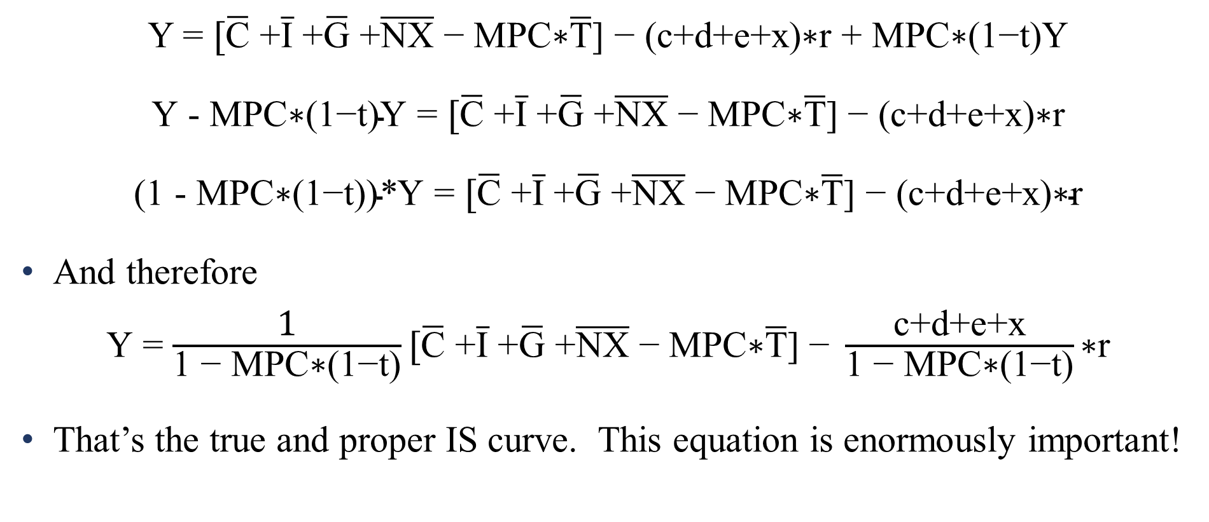

Expanded IS
Y = $[\overline{\text{C}}\text{ +}\overline{\text{I}}\text{ +}\overline{\text{G}}\text{ +}\overline{\text{NX}}\text{ − }\text{MPC}\text{∗}\overline{\text{T}}\text{] − (}\text{c}\text{+}\text{d}\text{+}\text{e}\text{+}\text{x}\text{)∗}\text{r}\text{ + }\text{MPC}\text{∗(1−}\text{t}\text{)}\text{Y}$
$\text{Y}\text{ − }\text{MPC}\text{∗(1−}\text{t}\text{)}\text{Y}$ = $[\overline{\text{C}}\text{ +}\overline{\text{I}}\text{ +}\overline{\text{G}}\text{ +}\overline{\text{NX}}\text{ − }\text{MPC}\text{∗}\overline{\text{T}}\text{] − (}\text{c}\text{+}\text{d}\text{+}\text{e}\text{+}\text{x}\text{)∗}\text{r}$
$\text{(1 −} \text{MPC}\text{∗(1−}\text{t}\text{))∗}\text{Y}$ = $[\overline{\text{C}}\text{ +}\overline{\text{I}}\text{ +}\overline{\text{G}}\text{ +}\overline{\text{NX}}\text{ − }\text{MPC}\text{∗}\overline{\text{T}}\text{] − (}\text{c}\text{+}\text{d}\text{+}\text{e}\text{+}\text{x}\text{)∗}\text{r}$
And therefore
$\text{Y}$ = $\frac{\text{1}}{\text{1 − }\text{MPC}\text{∗(1−}\text{t}\text{)}}[\overline{\text{C}}\text{ +}\overline{\text{I}}\text{ +}\overline{\text{G}}\text{ +}\overline{\text{NX}}\text{ − }\text{MPC}\text{∗}\overline{\text{T}}\text{] − }\frac{\text{c}\text{+}\text{d}\text{+}\text{e}\text{+}\text{x}}{\text{1 − }\text{MPC}\text{∗(1−}\text{t}\text{)}}\text{∗}\text{r}$
That’s the true and proper IS curve. This equation is enormously important!

Slide 14
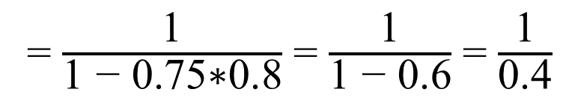
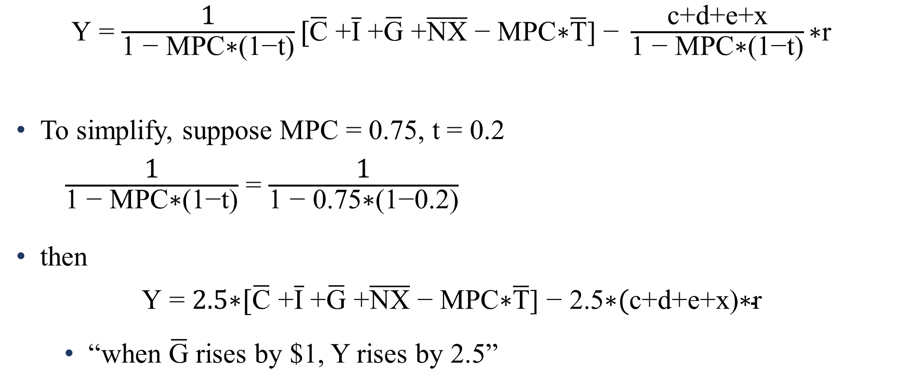
Expanded IS
$\text{Y}$ = $\frac{\text{1}}{\text{1 − }\text{MPC}\text{∗(1−}\text{t}\text{)}}[\overline{\text{C}}\text{ +}\overline{\text{I}}\text{ +}\overline{\text{G}}\text{ +}\overline{\text{NX}}\text{ − }\text{MPC}\text{∗}\overline{\text{T}}\text{] − }\frac{\text{c}\text{+}\text{d}\text{+}\text{e}\text{+}\text{x}}{\text{1 − }\text{MPC}\text{∗(1−}\text{t}\text{)}}\text{∗}\text{r}$
To simplify, suppose MPC = 0.75, t = 0.2
$\frac{\text{1}}{\text{1 − }\text{MPC}\text{∗(1−}\text{t}\text{)}}$ = $\frac{\text{1}}{\text{1 − }\text{0.75}\text{∗(1−}\text{0.2}\text{)}}$
then
$\text{Y}$ = $\text{2.5∗}\text{[}\overline{\text{C}}\text{ +}\overline{\text{I}}\text{ +}\overline{\text{G}}\text{ +}\overline{\text{NX}}\text{ − }\text{MPC}\text{∗}\overline{\text{T}}\text{] − }\text{2.5∗}(\text{c}\text{+}\text{d}\text{+}\text{e}\text{+}\text{x}\text{)}\text{∗}\text{r}$
“when $\overline{\text{G}}$ rises by $1, Y rises by 2.5”
= $\frac{\text{1}}{\text{1 − 0.75∗0.8}}$ = $\frac{\text{1}}{\text{1 − 0.6}}$ = $\frac{\text{1}}{\text{0.4}}$
= 2.5

Slide 15
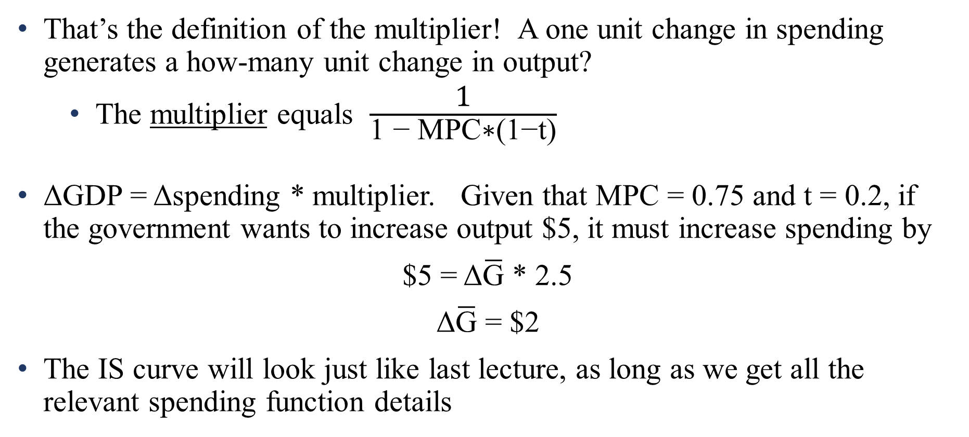
Expanded IS
That’s the definition of the multiplier! A one unit change in spending generates a how-many unit change in output?
The multiplier equals $\frac{\text{1}}{\text{1 − }\text{MPC}\text{∗(1−}\text{t}\text{)}}$
ΔGDP = Δspending * multiplier. Given that MPC = 0.75 and t = 0.2, if the government wants to increase output $5, it must increase spending by
$5 = Δ$\overline{\text{G}}$ * 2.5
Δ$\overline{\text{G}}$ = $2
The IS curve will look just like last lecture, as long as we get all the relevant spending function details

Slide 16
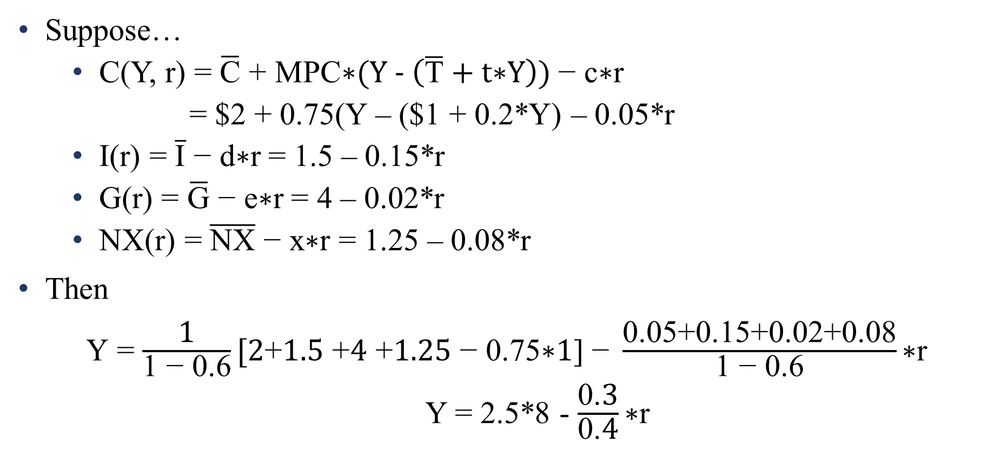

Expanded IS
Suppose…
C(Y, r) = $\overline{\text{C}}\text{ + }\text{MPC}\text{∗}\text{(}\text{Y}\text{ − }\left(\overline{\text{T}} \text{+ }\text{t}\text{∗}\text{Y}\right)\text{) }\text{− }\text{c}\text{∗}\text{r}$
= $2 + 0.75(Y – ($1 + 0.2*Y) – 0.05*r
I(r) = $\overline{\text{I}}\text{ − }\text{d}\text{∗}\text{r}$ = 1.5 – 0.15*r
G(r) = $\overline{\text{G}}\text{ − }\text{e}\text{∗}\text{r}$ = 4 – 0.02*r
NX(r) = $\overline{\text{NX}}\text{ − }\text{x}\text{∗}\text{r}$ = 1.25 – 0.08*r
Then
$\text{Y}$ = $\frac{\text{1}}{\text{1 − }\text{0.6}}[2\text{+}1.5\text{ +}4\text{ +}1.25\text{ − }\text{0.75}\text{∗}1\text{] − }\frac{\text{0.05+0.15+0.02+0.08}}{\text{1 − }\text{0.6}}\text{∗}\text{r}$
Y = 2.5*8 - $\frac{\text{0.}\text{3}}{\text{0.}\text{4}}\text{∗}\text{r}$
Notes:
We’ve already done the multiplier math, and MPC = 0.75 and t = 0.2, just like in the last slide.

Slide 17
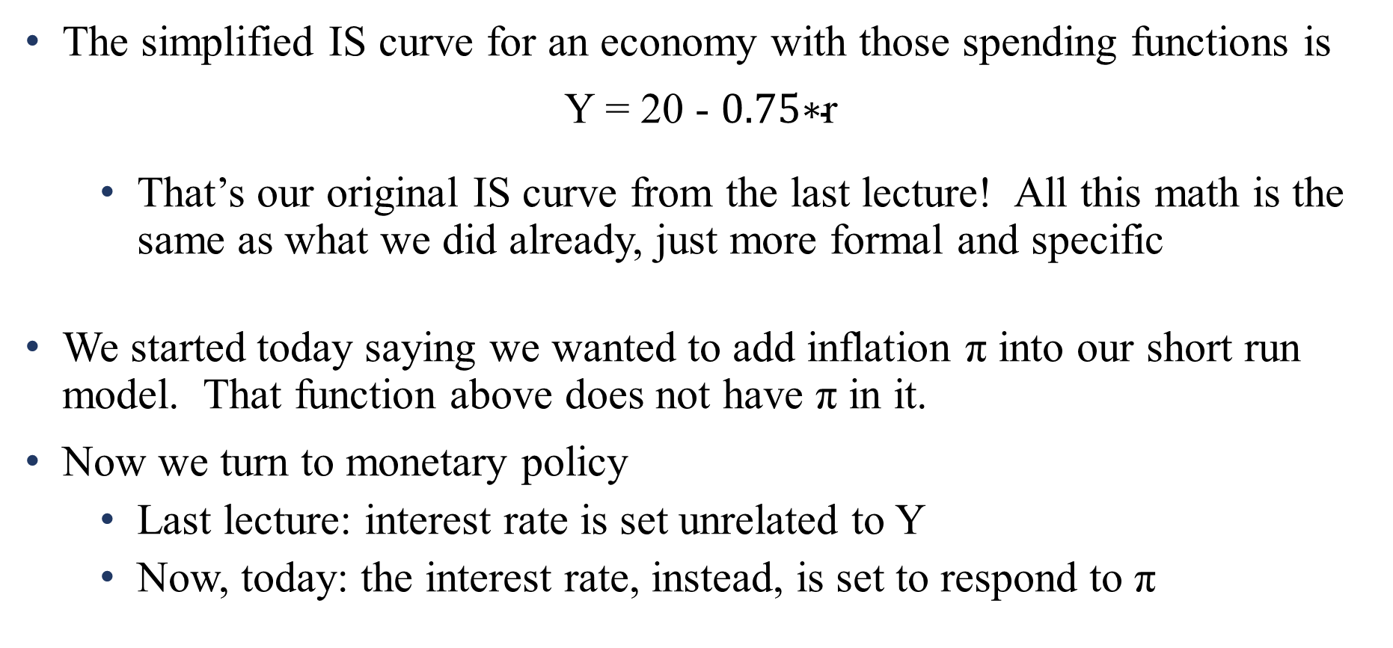
Expanded IS
The simplified IS curve for an economy with those spending functions is
Y = 20 - $0.75\text{∗}\text{r}$
That’s our original IS curve from the last lecture! All this math is the same as what we did already, just more formal and specific
We started today saying we wanted to add inflation π into our short run model. That function above does not have π in it.
Now we turn to monetary policy
Last lecture: interest rate is set unrelated to Y
Now, today: the interest rate, instead, is set to respond to π

Slide 18
Monetary policy and prices
As we briefly saw last class, the Fed maintains an inflation target
It declares that the economy should have a 2% rate of inflation (π =2)
When output grows especially quickly, this puts cost pressures on firms to raise their prices
They need more workers, there is more competition for inputs
As aggregate costs rise, firms raise aggregate prices to maintain profits.
In expansions, inflation tends to rise
In recessions, inflation tends to fall.
The Fed fights against this, countercyclically
Notes:
As you’re following along in Mishkin, everything before this today was Chapter 9. This part is Chapter 10.
We don’t have the model built yet, but eventually you could summarize this slide to say “when aggregate demand pushes output higher, we slide along the aggregate supply curve, which raises prices”

Slide 19
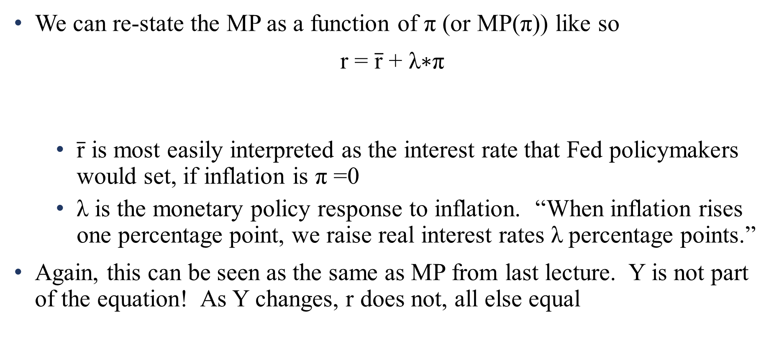
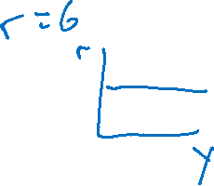
Monetary policy and prices
We can re-state the MP as a function of π (or MP(π)) like so
r = $\overline{\text{r}}\text{ + }\text{λ}\text{∗}\text{π}$
$\overline{\text{r}}$ is most easily interpreted as the interest rate that Fed policymakers would set, if inflation is π =0
$\text{λ}$ is the monetary policy response to inflation. “When inflation rises one percentage point, we raise real interest rates $\text{λ}$ percentage points.”
Again, this can be seen as the same as MP from last lecture. Y is not part of the equation! As Y changes, r does not, all else equal
The real interest rate
equals an autonomous component
, plus a portion that increases as inflation rises

Slide 20
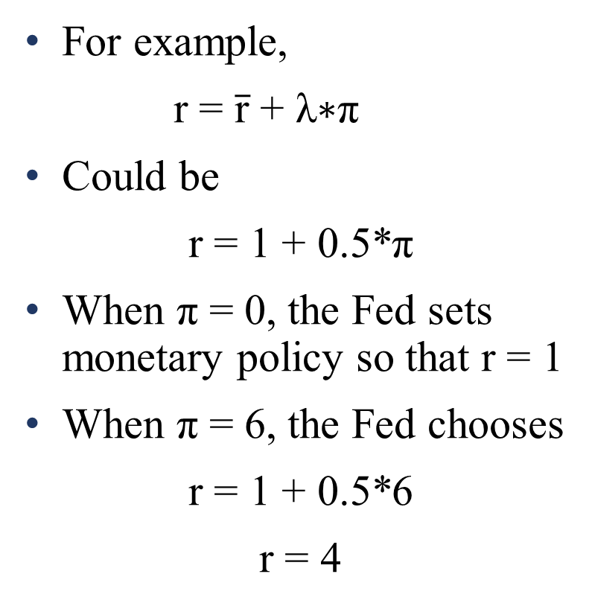
Monetary policy and prices
Real interest rate
r
For example,
r = $\overline{\text{r}}\text{ + }\text{λ}\text{∗}\text{π}$
Could be
r = 1 + 0.5*π
When π = 0, the Fed sets monetary policy so that r = 1
When π = 6, the Fed chooses
r = 1 + 0.5*6
r = 4
MP
r = 4%
r = 1%
6%
Inflation rate, π

Slide 21
Monetary policy and prices
The Fed is following The Taylor Rule, which says exactly what the MP equation says:
When the economy expands too fast, prices rise. We fight countercyclically against this by contracting – increasing r
In particular, the Taylor Rule says as inflation rises two points, interest should rise 1 point (we’ll return to this later)
It’s the same thing as last lecture’s MP curve, so shifters are the same
Monetary policy conducted for reasons other than changes in π
Changes in financial market risk premia

Slide 22
Monetary policy and prices
Monetary policy…
Has an impact on spending, via IS-MP, and
Responds to changes in inflation
Therefore, there is a well-defined relationship between consumer spending and inflation, via monetary policy.
That relationship is the Aggregate Demand curve
Graph it!

Slide 23
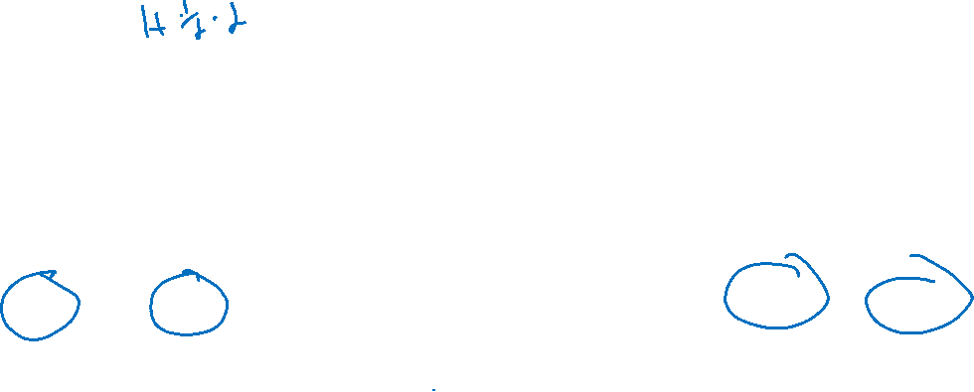
Real interest rate
r
r
MP(π):
r = 1 + 0.5π
IS(r):
Y = 20 – 0.75r
r = 6%
MP₂
r = 6%
r = 2%
MP₁
r = 2%
2%
10%
inflation (π)
$15.5
$18.5
Y
π
π = 10%
π = 2%
AD
Y
$15.5
$18.5

Slide 24
Aggregate Demand
Aggregate demand represents the change in desire to spend, from the perspective of households, firms, government, and foreigners, as the rate of inflation changes.
It is very literally aggregate expenditure as it relates to changes in the price level, rather than changes in the interest rate
It’s an alternate version of IS. Same spending, same spenders. Different vertical axis.
AD allows us to model changes in output and changes in prices together.
The mathematical version of the last graph is quite simple
Think of MP(π) as an equation that “translates between” r into π

Slide 25

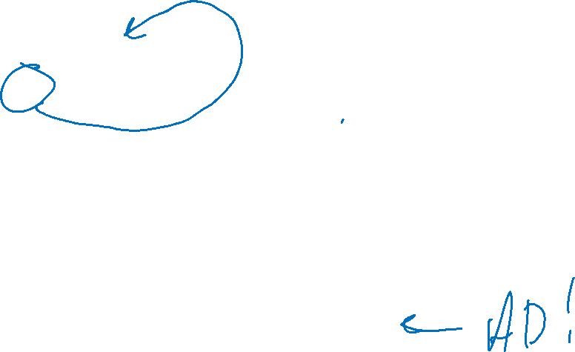
Aggregate Demand
In today’s example
IS: Y = 20 - $\frac{3}{4}\text{∗}\text{r}$
MP(π): r = 1 + 0.5*π
Just plug MP into IS. Where you see r, substitute 1+0.5*π
Y = 20 - $\frac{3}{4}\text{∗}\text{(}\text{1 + 0.5∗}\text{π}\text{)}$
Y = 20 - $\frac{3}{4}\text{ − }\frac{3}{4}\text{∗}\text{0.5∗}\text{π}$
Y = 19.25 - $\frac{3}{8}$ $\text{∗}\text{π}$
Notes:
And hey, 19.25 is the example from last class of the value of Y when r=1. We know from MP(π) what r=1 when π=0. 19.25-0 = 19.25! The system works!

Slide 26
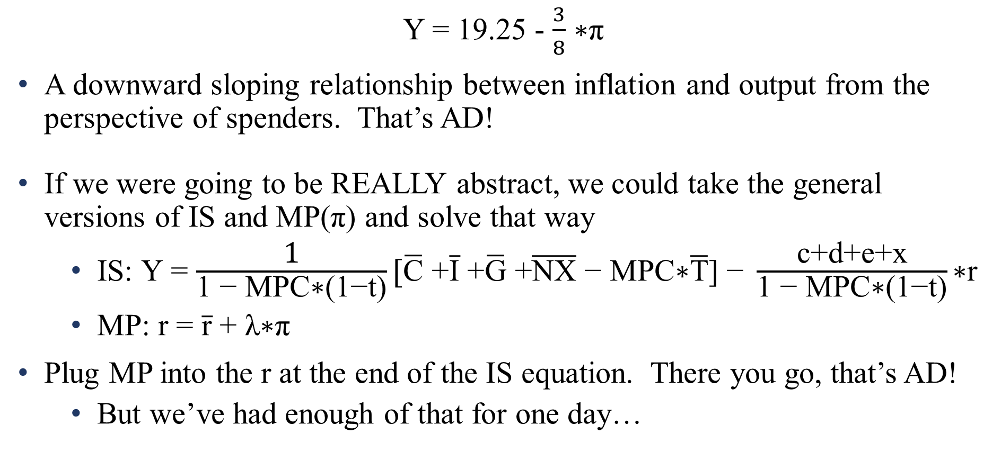
Aggregate Demand
Y = 19.25 - $\frac{3}{8}$ $\text{∗}\text{π}$
A downward sloping relationship between inflation and output from the perspective of spenders. That’s AD!
If we were going to be REALLY abstract, we could take the general versions of IS and MP(π) and solve that way
IS: $\text{Y}$ = $\frac{\text{1}}{\text{1 − }\text{MPC}\text{∗(1−}\text{t}\text{)}}[\overline{\text{C}}\text{ +}\overline{\text{I}}\text{ +}\overline{\text{G}}\text{ +}\overline{\text{NX}}\text{ − }\text{MPC}\text{∗}\overline{\text{T}}\text{] − }\frac{\text{c}\text{+}\text{d}\text{+}\text{e}\text{+}\text{x}}{\text{1 − }\text{MPC}\text{∗(1−}\text{t}\text{)}}\text{∗}\text{r}$
MP: r = $\overline{\text{r}}\text{ + }\text{λ}\text{∗}\text{π}$
Plug MP into the r at the end of the IS equation. There you go, that’s AD!
But we’ve had enough of that for one day…

Slide 27
Aggregate Demand
We know where AD comes from: IS and MP(π)
And we know what shifts IS and MP – that was the whole last class
shifters of C, I, NX (IS shifters)
Fiscal policy (IS shifter)
Monetary policy (MP shifter)
Therefore, those same exact things shift AD!
When the MP or IS equations change, the AD equation will change.
Our tools of countercyclical policy are AD shifters. Our tools of countercyclical policy affect spending.

Slide 28
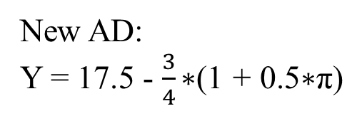
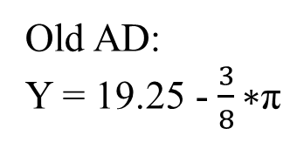
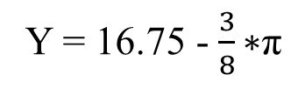
Real interest rate
r
r
MP(π):
r = 1 + 0.5π
Old IS(r):
Y = 20 – 0.75r
r = 6%
MP₂
r = 6%
New IS(r):
Y = 17.5 – 0.75r
10%
inflation (π)
$13
$15.5
Y
π
New AD:
Y = 17.5 - $\frac{3}{4}\text{∗(}\text{1 + 0.5∗}\text{π}\text{)}$
Old AD:
Y = 19.25 - $\frac{3}{8}\text{∗}\text{π}$
π = 10%
Y = 16.75 - $\frac{3}{8}\text{∗}\text{π}$
AD₂
AD₁
Y
$13
$15.5
Notes:
This new IS curve is, again, exactly the same as one of the ones I used last lecture

Slide 29
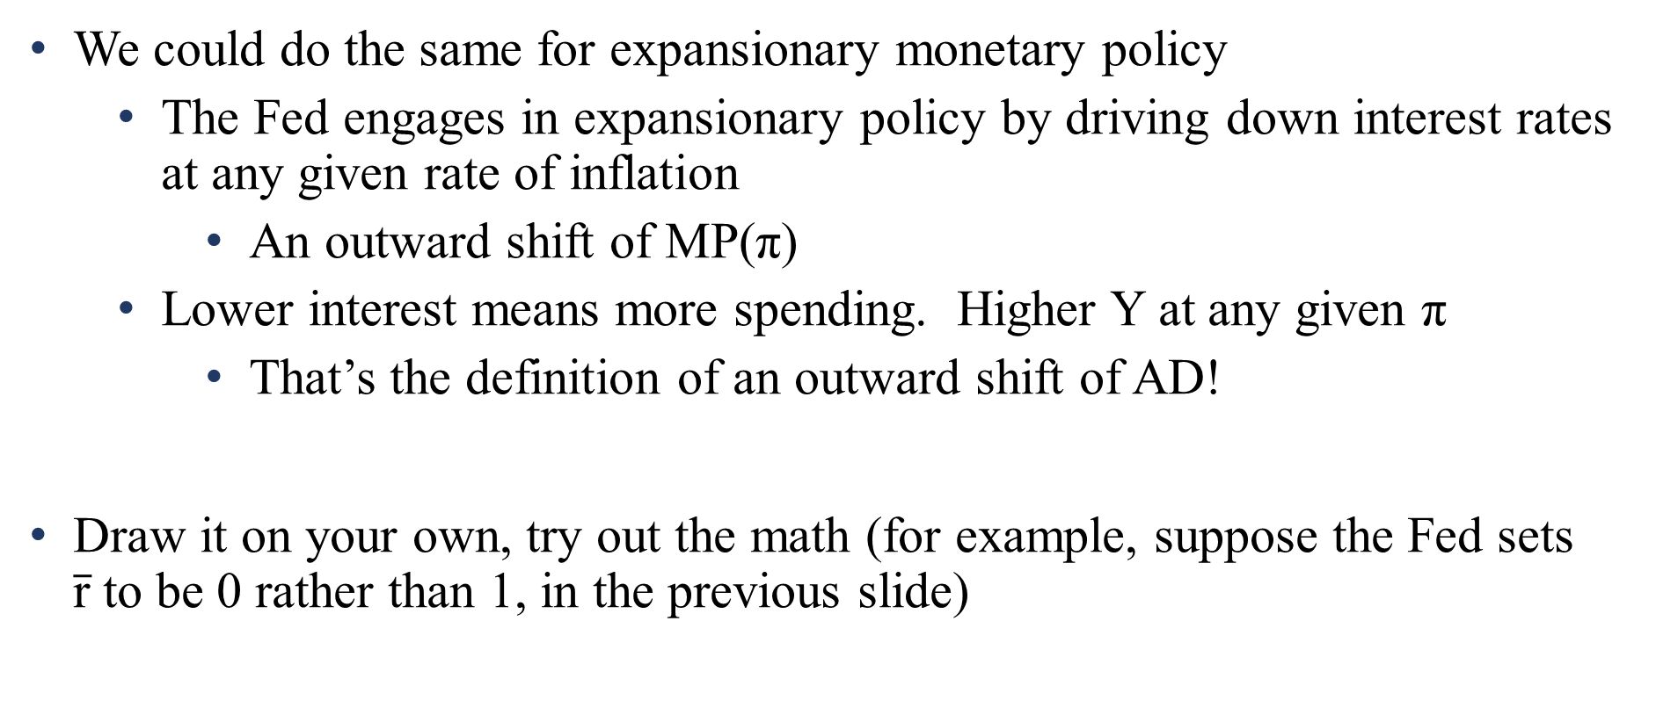
Aggregate Demand
We could do the same for expansionary monetary policy
The Fed engages in expansionary policy by driving down interest rates at any given rate of inflation
An outward shift of MP(π)
Lower interest means more spending. Higher Y at any given π
That’s the definition of an outward shift of AD!
Draw it on your own, try out the math (for example, suppose the Fed sets $\overline{\text{r}}$to be 0 rather than 1, in the previous slide)

Slide 30
Next:
Equilibrium in the Short Run

